Slide 1


06. Quantum Power Usage

Slide 2
Agenda
Assignment Review
Returning Values from steps
Utils Classes
Querying with getBundle
Desktop Web
Assignment
Notes:
Today we will go over a series of utils and options available in Quantum that make the work of implementing step definitions in Java easier and quicker.

Slide 3
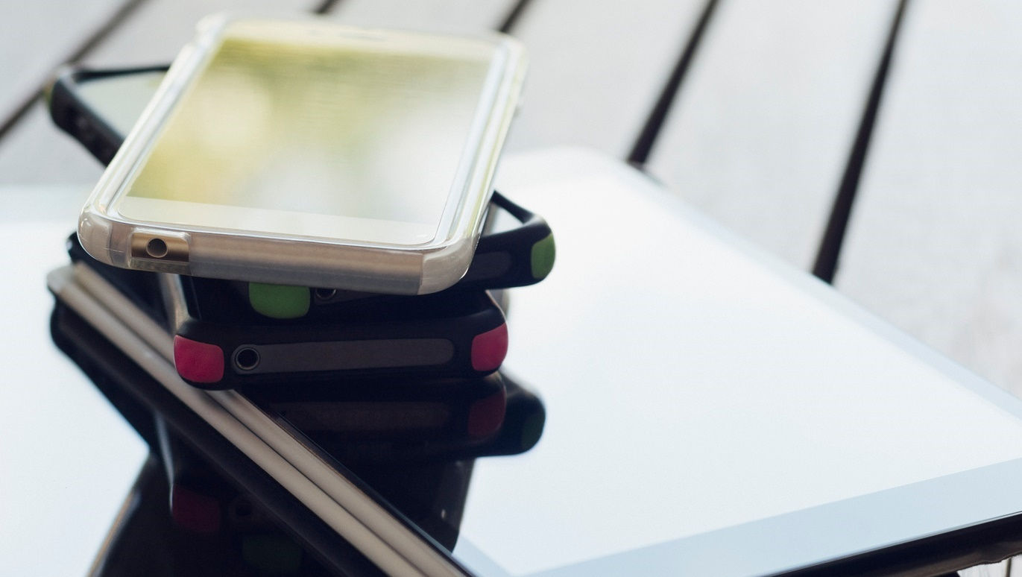
Assignment Review

Slide 4
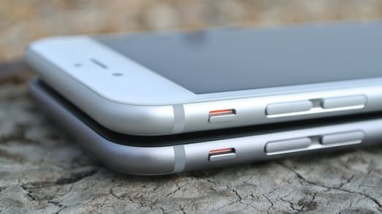
Getting Values from Steps

Slide 5
Returning Values from Steps
We have implemented steps that are standalone
Steps can receive data from the scenario and that data can come from an external file
In some cases, we will want to get the data from a previous step e.g. compare a promotional price we get in the homepage to the price in the shopping cart.
Let’s look at the sample to see how this is done
Notes:
Today we will go over a series of utils and options available in Quantum that make the work of implementing step definitions in Java easier and quicker.

Slide 6
Returning Values from steps - Summary
We create a step which is not void – String, Int etc.
We store the data into a meaningful name
We can now use the data in any step we want.

Slide 7
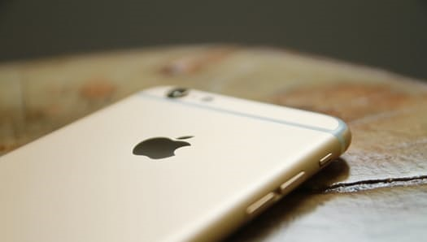
Utils Classes

Slide 8

Utils Classes
Quantum Contains Utils classes
They contain many useful commands
We’ll look at them in detail
Remember, you can also create your own utils!
More info - https://github.com/Project-Quantum/Quantum/tree/master/src/main/java/com/quantum/utils

Slide 9
Getting to know the Utils
Name | Description
Appium Utils | Appium commands – scroll, dates & more
CloudUtils | Perfecto connection. For advanced users only.
Console Utils | IDE console print outs. For advanced users only
ConfigurationUtils | Contains GetBundle for querying open device
DeviceUtils | Application handling, visual commands, location & more!
DriverUtils | Handles the Appium driver. Contains methods for querying OS
ReportUtils | Perfecto report integration. For advanced users only.
Notes:
Go into all the classes from Quantum, show the auto complete and go into the actual class.
In the device Utils, spend several minutes showing all the methods.

Slide 10
Accessing Commands
All Perfecto commands can be executed from Quantum
The full list of commands - http://developers.perfectomobile.com/display/PD/Perfecto+Commands
Quantum Utils contain with pre-built calls to most commands.
When you want to use a command, start by looking in the Utils, if your command is not found create your own Util.
Selenium commands are all available under the getDriver()

Slide 11

Querying with GetBundle

Slide 12
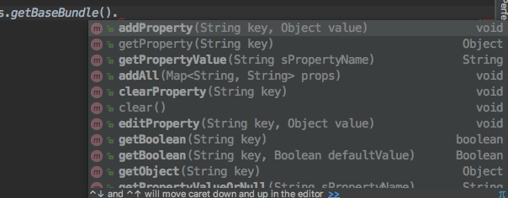
getBaseBundle
The getBaseBundle() is in the configurationUtils class
Allows querying properties from within the Java steps

Slide 13
Summary
Quantum provides many utils to help in writing the step definitions
Steps can return a value which can be stored for future use
Properties can be accessed from within the Java steps

Slide 14

Desktop Web

Slide 15
Desktop Web & Perfecto
Includes Mac & Windows
Supports Firefox, Chrome, IE, Safari, Edge
Testing for both mobile & desktop is supported by Quantum
Info - http://developers.perfectomobile.com/display/PD/Desktop+Web+Testing
Desktop Web is a separate license from the mobile devices
One codebase and one tool for all the test automation

Slide 16
How it works – Launching desktop web
Launching a desktop web instance is similar to a mobile device.
The capabilities are defined in the TestNG and when the test is executed a driver is created with the required desktop machine.
Let’s look at the configuration in Quantum
Application properties
TestNG File
Notes:
CHECK if the customer is currently using desktop web testing. If not, skip the configuration and just show the demo.
We are going to run a desktop web script. Before we run the script we will look at the configuration in Quantum for executing desktop web.
In the testNG we added a deviceType capability, it is not required for the execution but it is very helpful in case we need to create a branch for web or mobile.
Show the isMobile method in the utils and how it is used in the sample.

Slide 17
Running a test
We can write the same test and execute it across mobile & desktop
The website needs to be identical on the object level for this to work.
Responsive websites which look different due to different CSS but are in fact identical will be fine.
For more info on testing with Desktop see here - http://developers.perfectomobile.com/display/TT/Desktop+Web+Testing
Notes:
Run the sample desktopWeb.
Show how both a mobile and a desktop are running.
Show the results in the report.

Slide 18

We are near the end!
Our next session will be the last.
This is a good time to collect all your questions everything Perfecto related
We will have an open Q&A session in our next meeting.

Slide 19

Assignment
Notes:
This assignment is relevant only for customers that are currently using desktop web. Customers who do not have this do not have an assignment to do for this module.

Slide 20
Assignment
Take the Wikipedia sample we have created and run make run it on a desktop as well as a mobile device
Add the security token to the app properties file
Create a testNG file and add 2 tests – for mobile and desktop
Create the capabilities required
Run the script

Slide 21
Resources
Quantum wiki - https://github.com/Project-Quantum/Quantum-Starter-Kit/wiki
Perfecto Commands - http://developers.perfectomobile.com/display/PD/Perfecto+Commands
Quantum Utils - https://github.com/Project-Quantum/Quantum/tree/master/src/main/java/com/quantum/utils
Desktop Web testing - http://developers.perfectomobile.com/display/PD/Desktop+Web+Testing

